Slide 1

SEC285
Course Project
By: Gabriel Sandoval

Slide 2

Introduction
In this course, we have created different security measures to gain access to virtual machines while also understanding different network security measures.

Slide 3

Module 2
Asymmetric Key Encryption

Slide 4
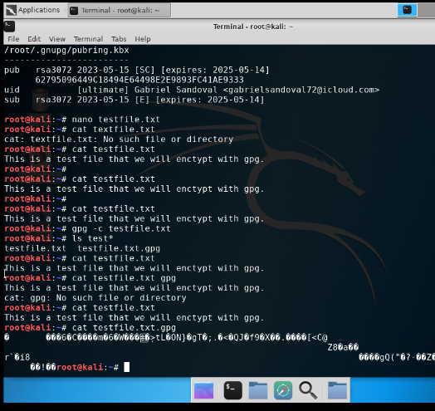
File Encryption
This screenshot shows the following.
Content of the plaintext file
Content of the encrypted file

Slide 5
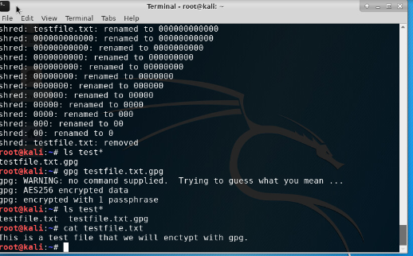
File Decryption
This screenshot shows the following.
The encrypted file being listed by itself
The decrypting process
Both the encrypted file and the original plaintext file are listed

Slide 6
SEC285
Module 3
Stateful Firewall

Slide 7

Question
What effect does the sudo iptables --policy INPUT DROP command have on the access to computing resources?
Answer here: This command blocks the web traffic that is coming into the system.

Slide 8
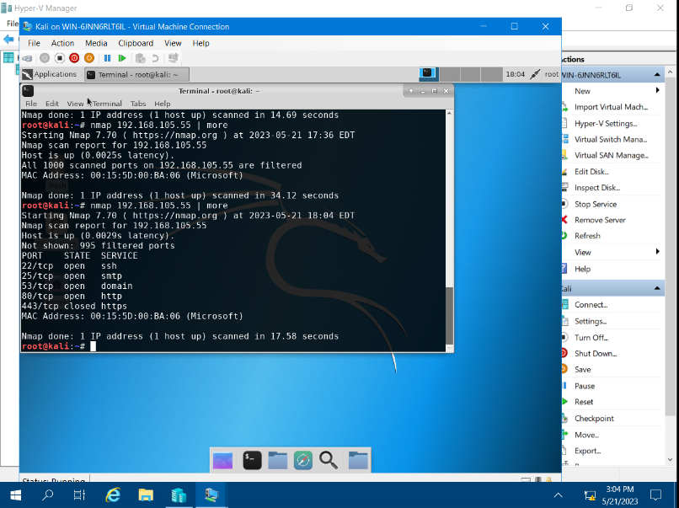
Nmap Scan
This screenshot shows the Nmap scan result of the Linux Server VM.

Slide 9

BYOB Security Policy

Slide 10
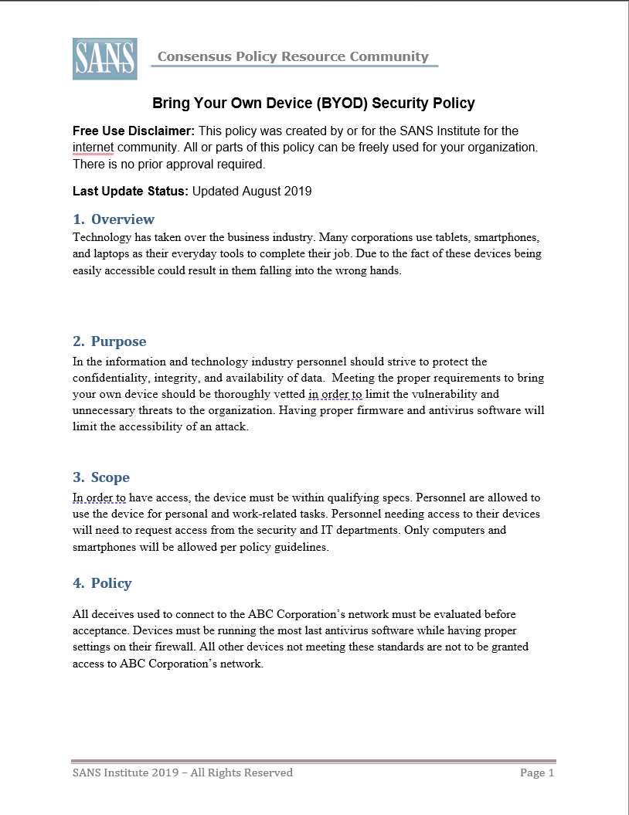

Slide 11
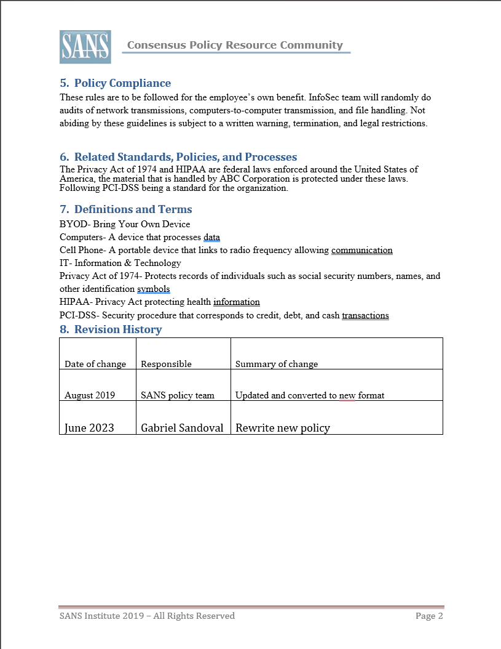

Slide 12

SEC285
Module 5
Multifactor Authentication (MFA)

Slide 13
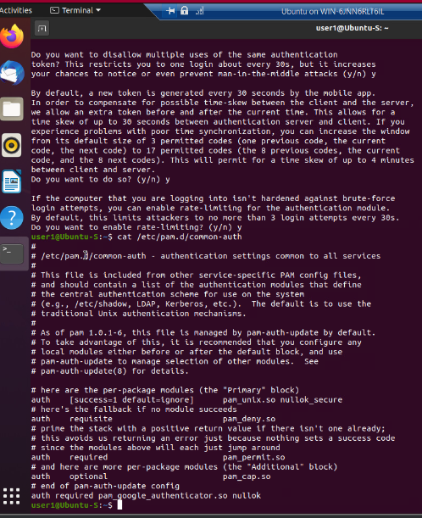
Common-auth Configuration File
This screenshot shows the entry that indicates the use of the Google Authenticator module.

Slide 14
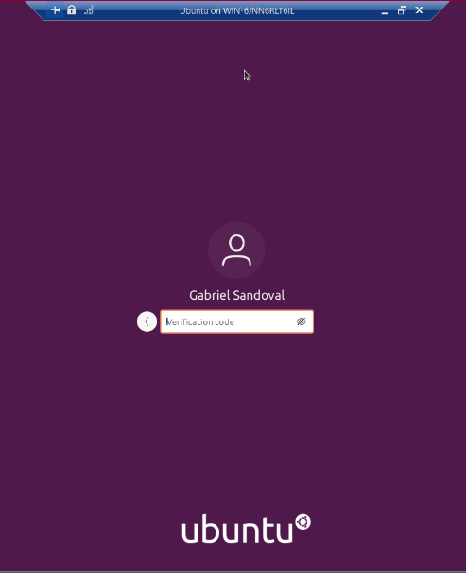
MFA Logon Screen
This screenshot shows the logon screen where a verification code is required.

Slide 15
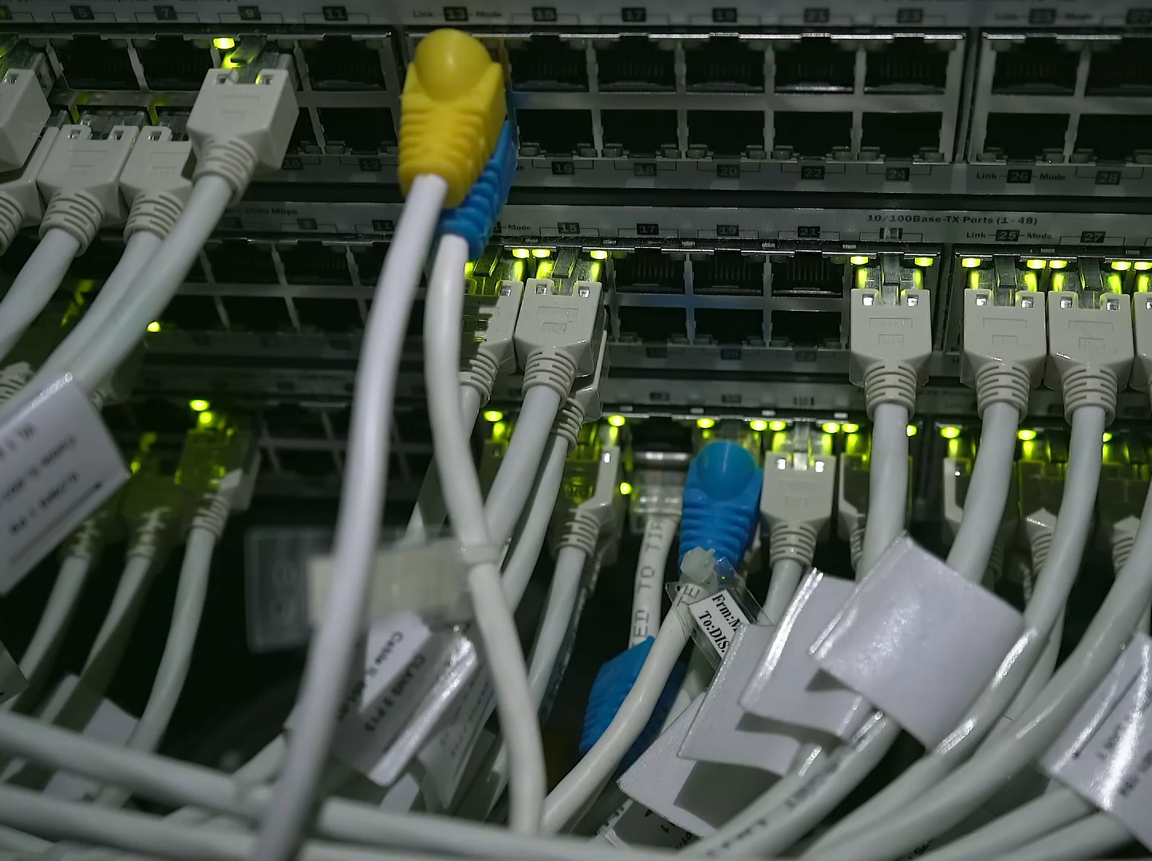
SEC285
Module 6
Vulnerability Assessment

Slide 16
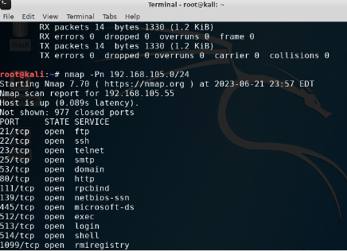
Nmap
This screenshot includes the scan result showing both the Kali and Linux Server VMs.

Slide 17
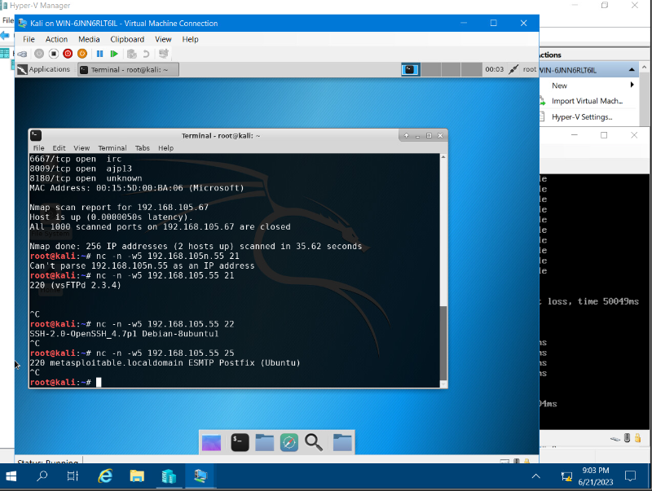
NetCat
This screenshot includes the scan result showing both the Kali and Linux Server VMs.

Slide 18
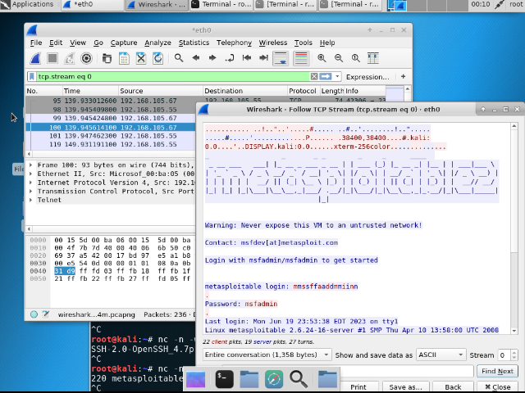
Wireshark
This screenshot includes the Wireshark—Follow TCP Steam window showing the Telnet username and password.

Slide 19
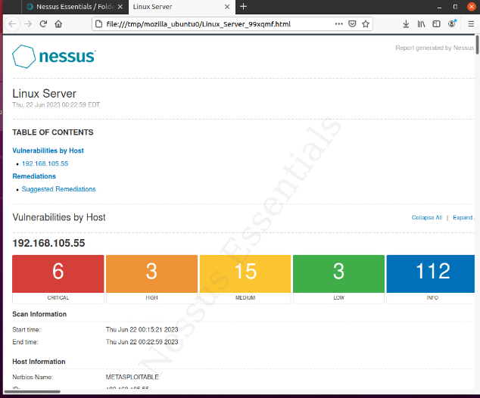
Nessus
This screenshot includes the high-level view of the Nessus vulnerability scan report (showing categories of vulnerability in different colors).

Slide 20

Challenges
Multifactor Authentication
Understanding and writing policies
Trouble shooting

Slide 21

Career Skills
Understanding policies
Multi-factor authenticator
Enhance network security
Properly write codes

Slide 22

Conclusion
This course has allowed me to better understand and properly use network security measures. While teaching me many other skills.

Slide 23

References
course reference video

