Slide 1

NETW211 Course Project
By: Gabriel Sandoval

Slide 2
Introduction
In this course we were able to understand the process of setting up multiple virtual machines while understanding and learning the process of cloud computing.

Slide 3

Module 2 Virtual Machine (VM) Instances

Slide 4
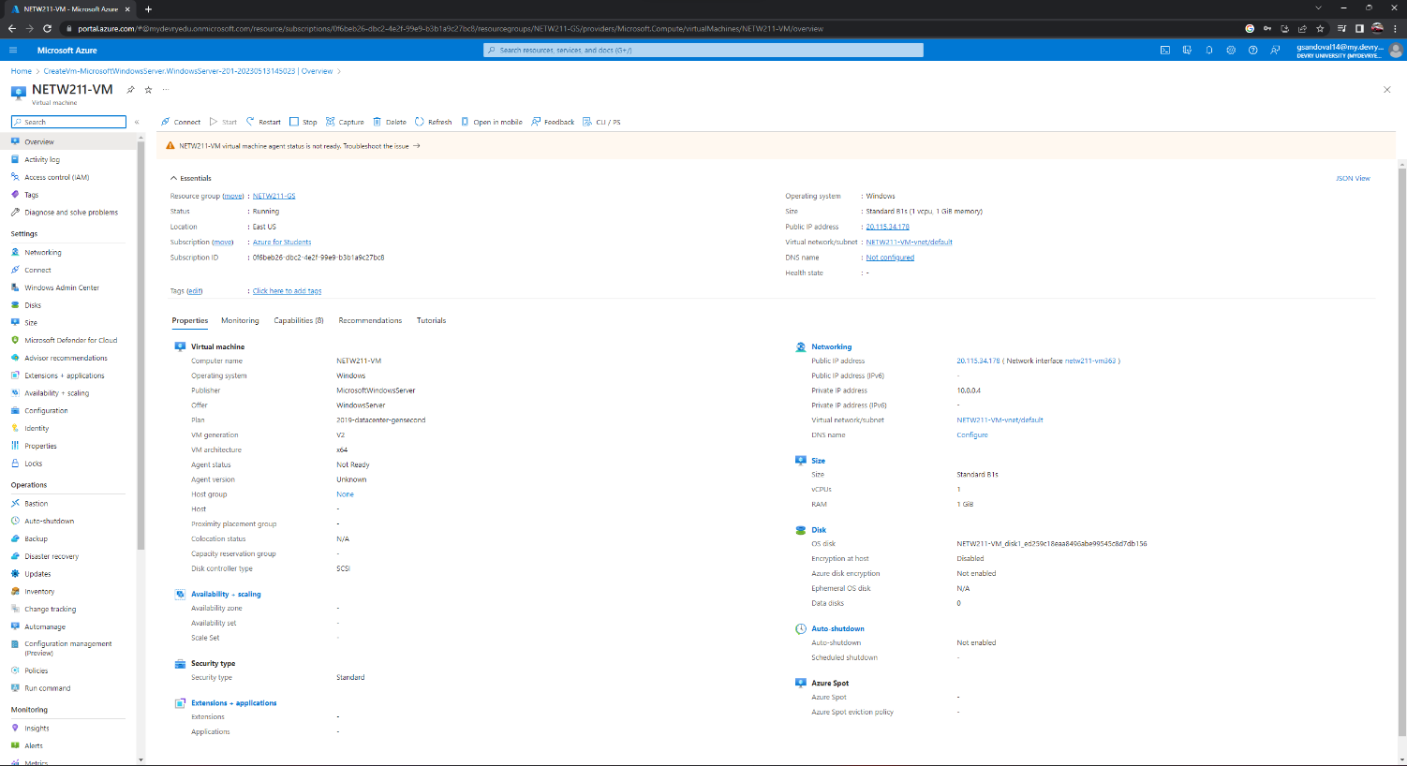
Deploying a VM in Azure
This screenshot shows the NETW211VM page with information such as the resource group name, subscription, public IP address, etc.

Slide 5
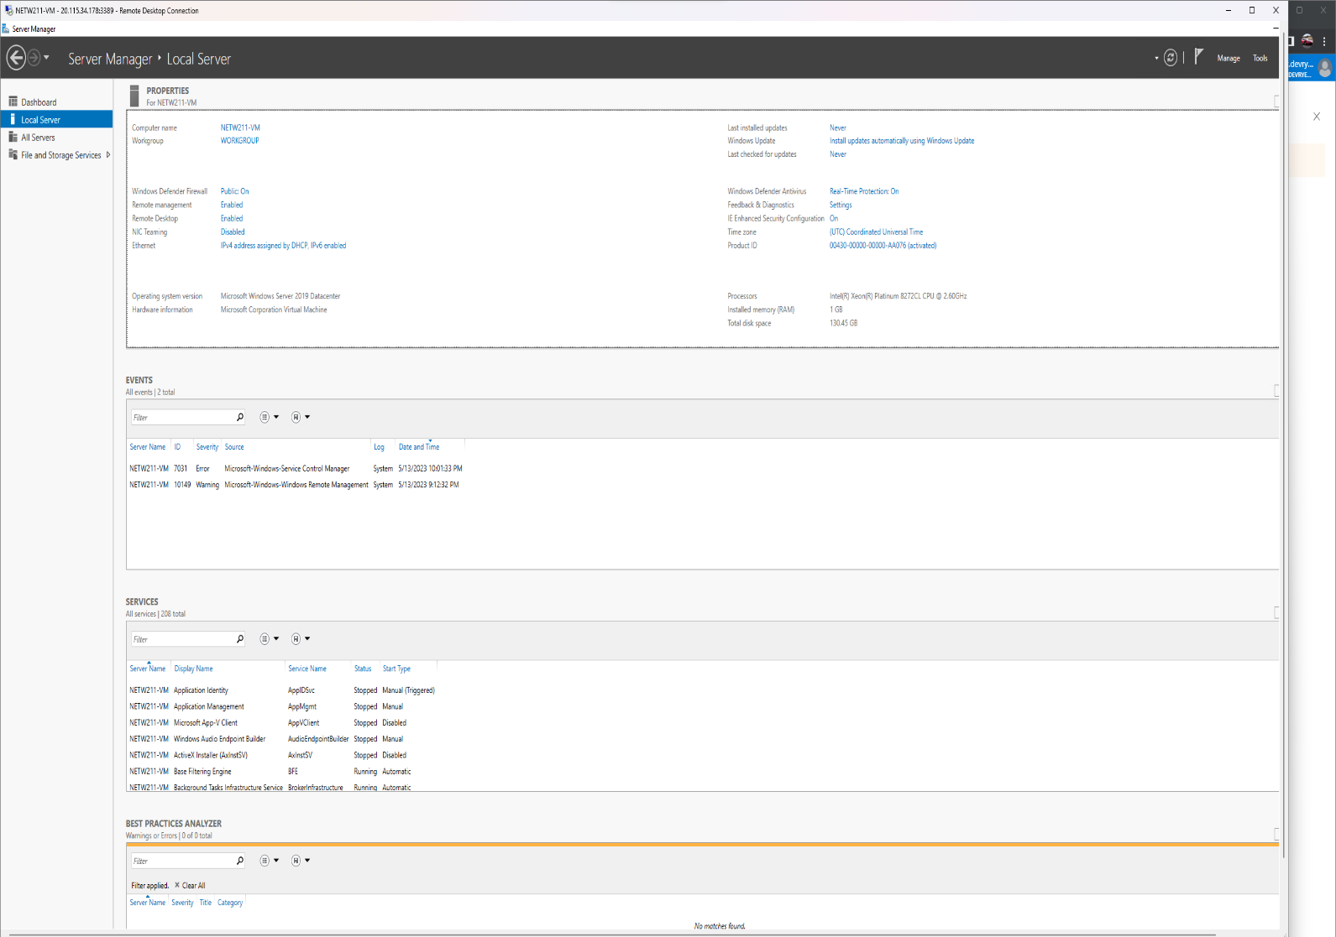
Connecting to the VM
This screenshot shows the PROPERTIES for NETW211VM page, with the computer name, operating system version, hardware information, etc.

Slide 6
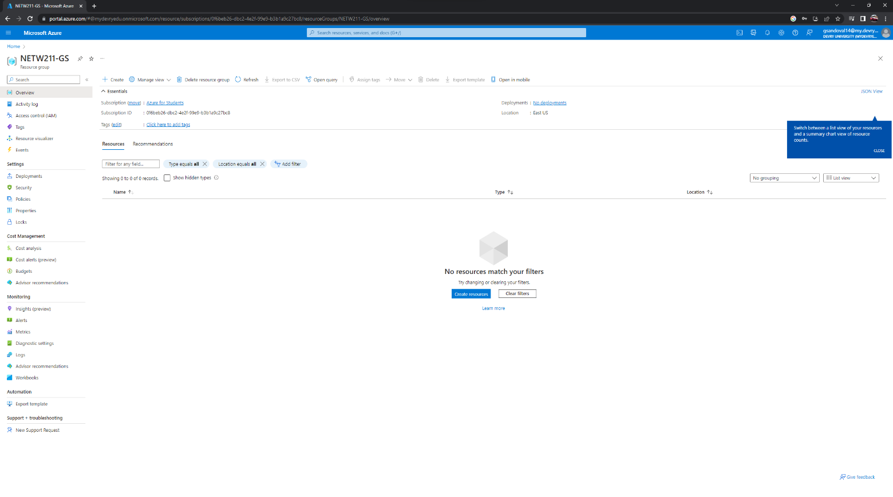
Deleting
the VM
This screenshot shows the Resource groups page, with the Subscription == all selection, but without the NETW211-XX (Your Initials) resource group listed.

Slide 7

NETW211 Course Project
Module 3 Azure VNet and Subnets

Slide 8

Creating a VNet with Two Subnets
1. With a /24 network prefix, how many usable IPv4 host addresses are there? [hint: you learned this in NETW191]
Answer here: 254
2. Given the answer above, why is the number of available IP addresses for Subnet0 (10.0.0.0/24) or Subnet1 (10.0.1.0/24) shown as 251? [hint: where did the missing addresses go?]
Answer here: Azure reserves IP address for its own use.
References (here are two examples to get your research started):
1. IP Subnet Calculator, https://www.calculator.net/ip-subnet-calculator.html
2. Azure Virtual Network frequently asked questions, https://docs.microsoft.com/en-us/azure/virtual-network/virtual-networks-faq
3. Caseres, M. (2021, May 18). VPC Basics for AWS Solutions Architect associate exam. Medium. https://aws.plainenglish.io/vpc-basics-for-aws-solutions-architect-associate-exam-273dd3491e4

Slide 9
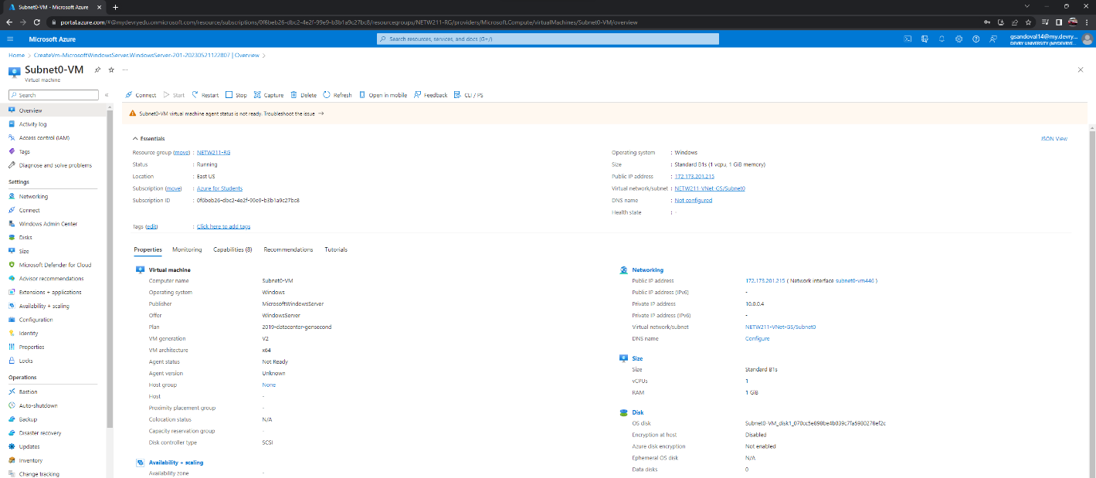

Deploying VMs into Subnets
This screenshot shows the Properties section of the Subnet0-VM page, showing the networking and size information of the VM.

Slide 10
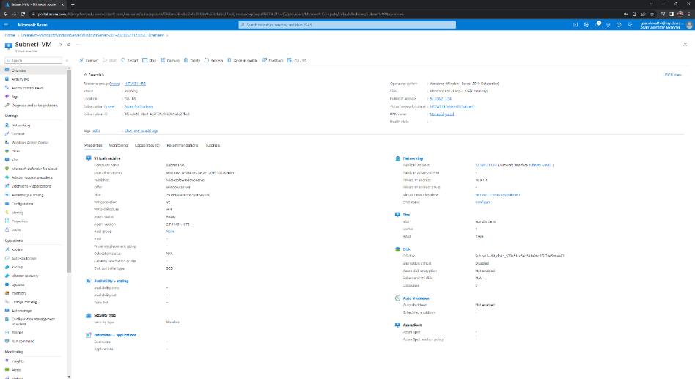
Deploying VMs into Subnets cont’d
This screenshot shows the Properties section of the Subnet1-VM page, showing the networking and size information of the VM.

Slide 11
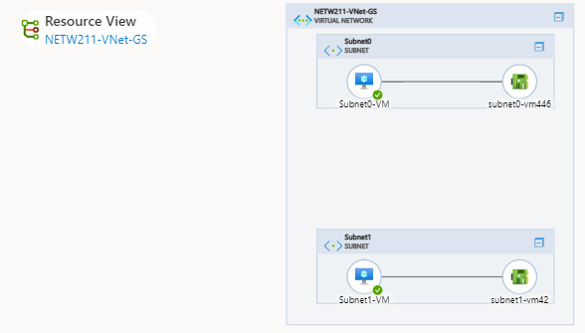
Deploying VMs into Subnets cont’d
This screenshot shows the topology diagram of your VNet (NETW211-VNet-Your Initials) with two subnets (Subnet0 and Subnet1) and one VM in each subnet (Subnet0-VM and Subnet1-VM).

Slide 12
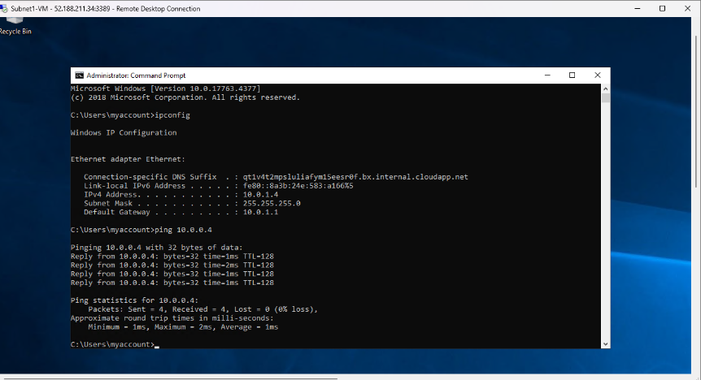
This screenshot shows the ipconfig and ping x.x.x.x results in the command prompt window, including the Subnet0-VM – x.x.x.x – Romote Desktop Connection window title.
Verifying Connectivity between VMs

Slide 13
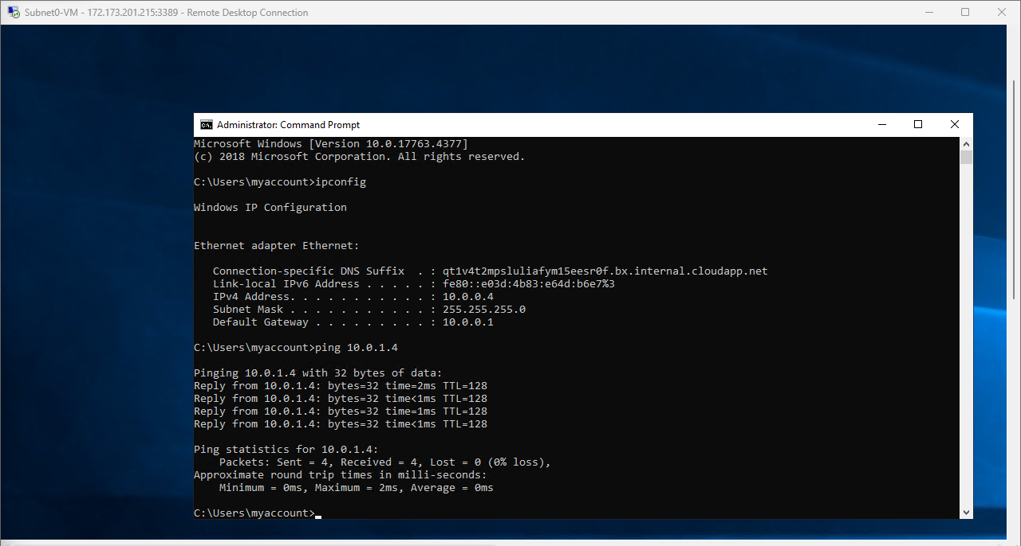
Verifying Connectivity between VMs
cont’d
This screenshot shows the ipconfig and ping x.x.x.x results in the command prompt window, including the Subnet1-VM – x.x.x.x – Romote Desktop Connection window title.

Slide 14
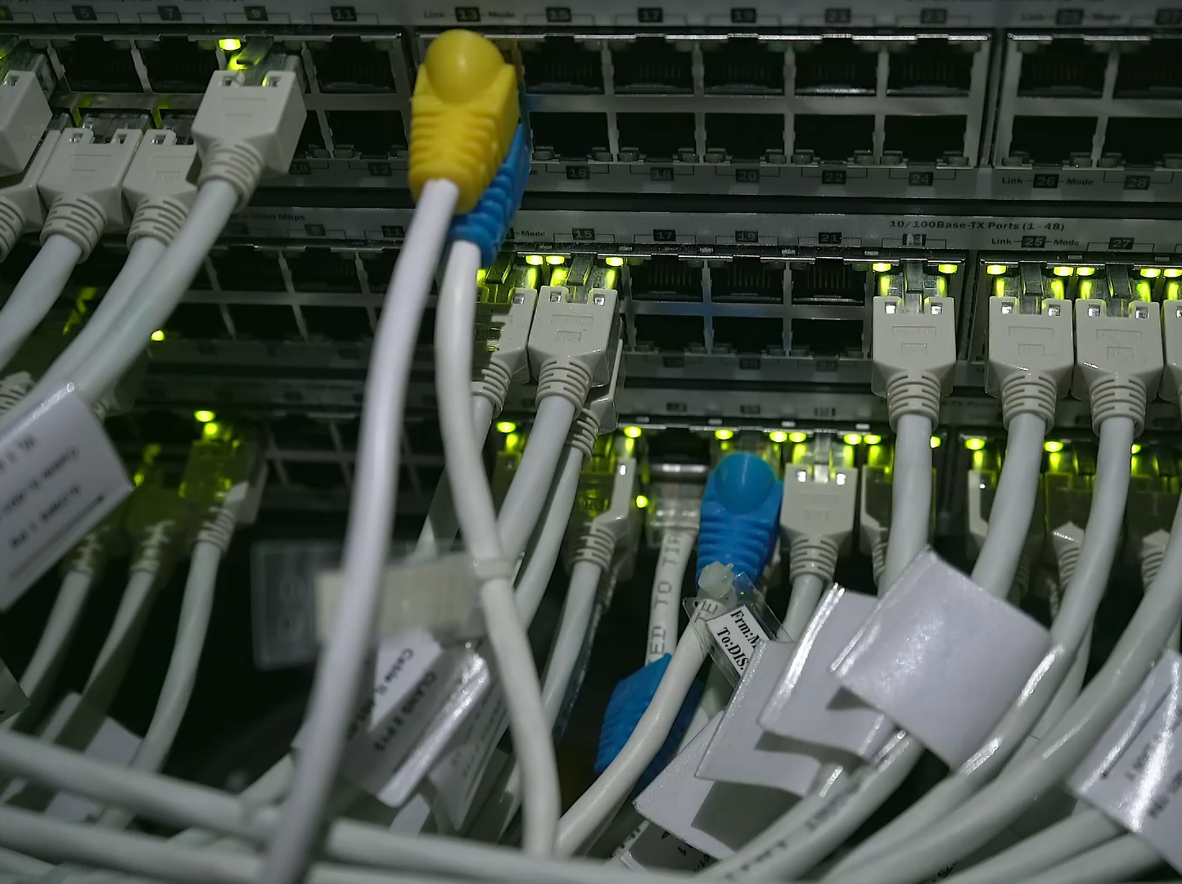
NETW211 Course Project
Module 4 Azure VM Security

Slide 15
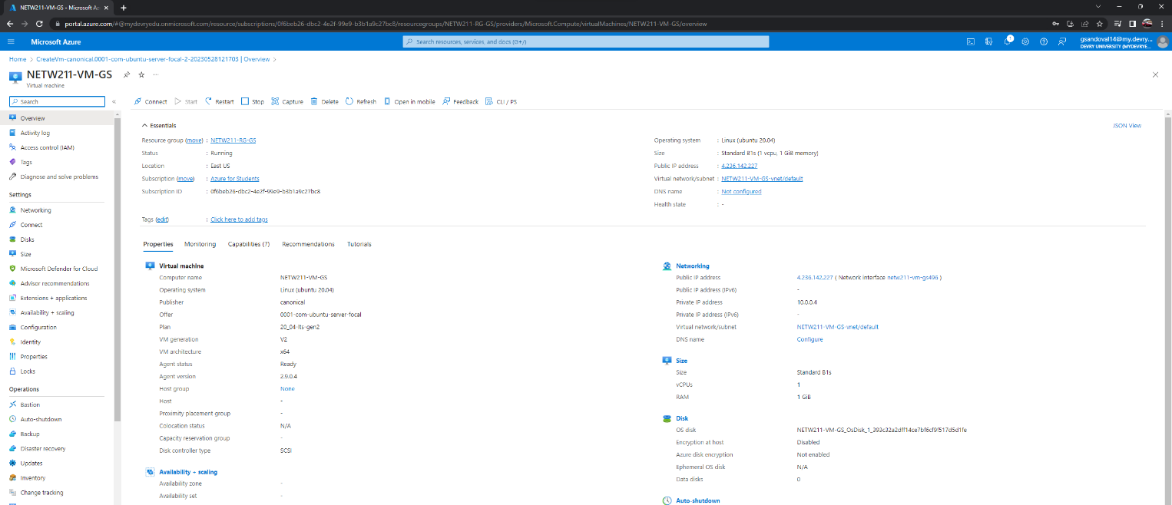
Launching a VM
This screenshot shows the NETW211-VM-Your Initials page, with information such as the resource group name, subscription, public IP address, etc.

Slide 16
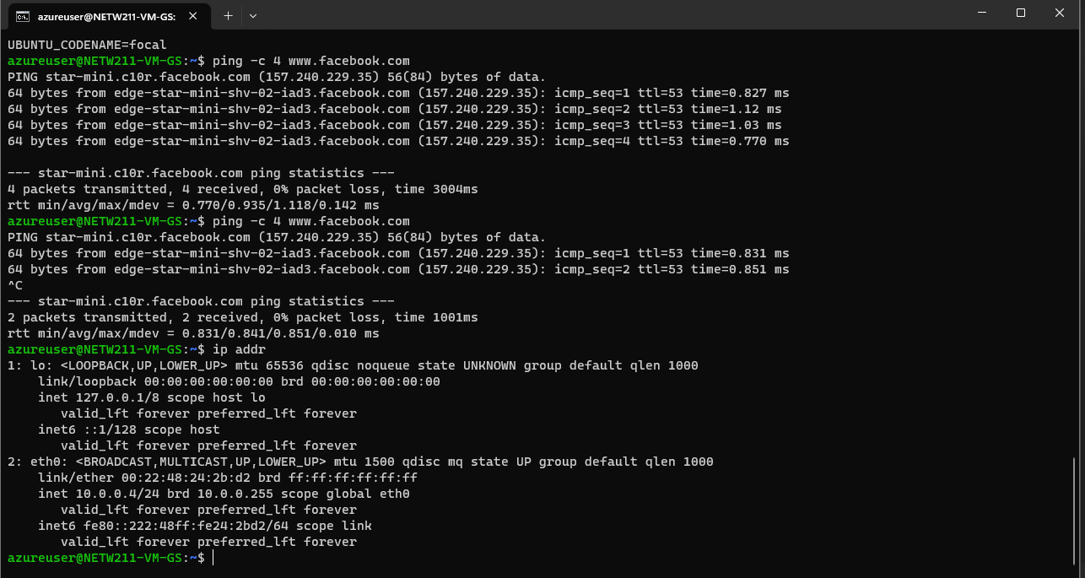
Connecting to the VM
via SSH
This screenshot shows the azureuser@NETW211-VM-Your Initials window showing the IPv4 address of the VM in the Azure cloud.

Slide 17
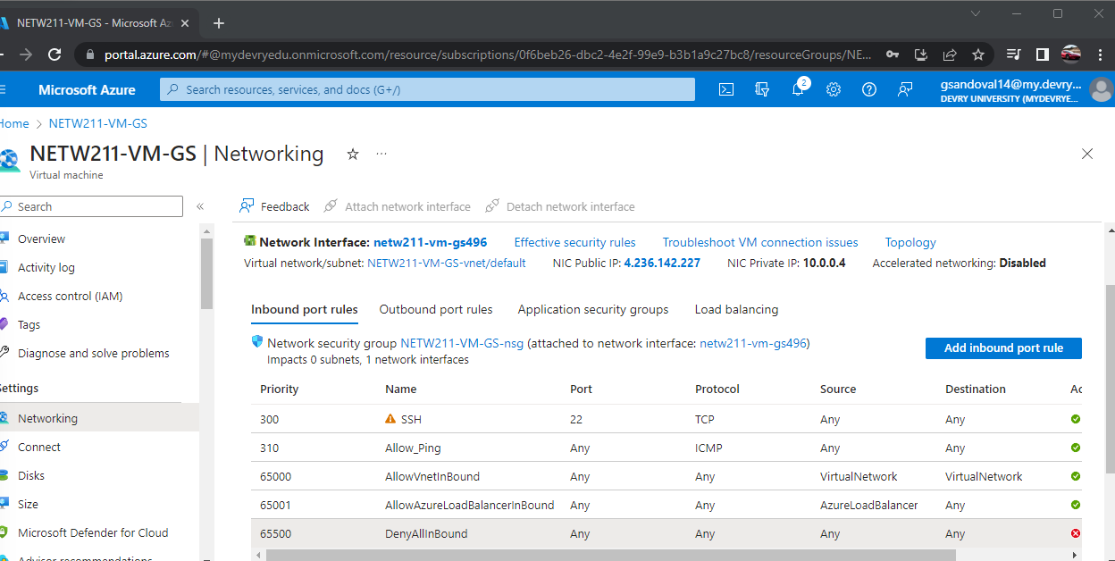
Configuring an NSG
This screenshot shows the Inbound port rules section with the newly added Allow_Ping rule.

Slide 18
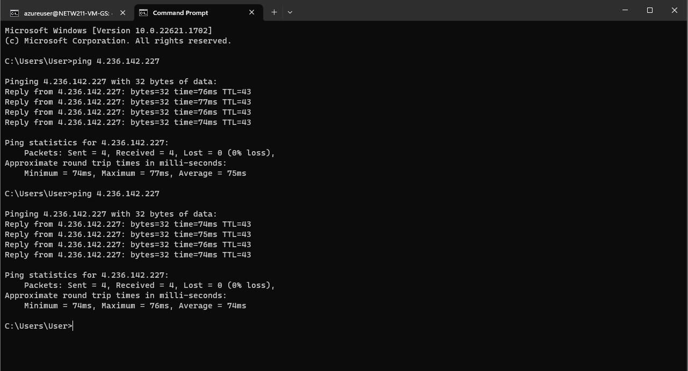
Configuring an NSG
cont’d
This screenshot shows the successful ping result from your local computer to the VM in the Azure cloud.

Slide 19

NETW211 Course Project
Module 5 Cloud Storage

Slide 20
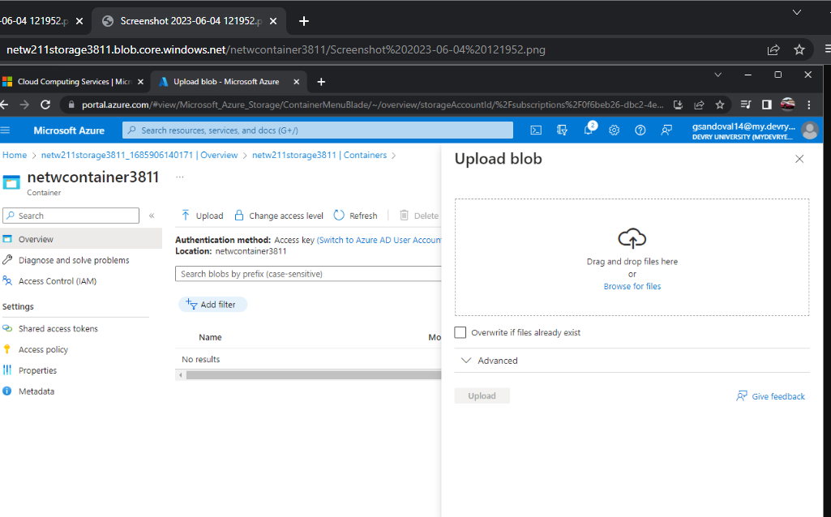
Uploading and Accessing a File
This screenshot shows the browser window with the image uploaded from your local computer and the URL on top of the window.

Slide 21

Question
What does the access tier setting do? What are the Azure blob storage access tiers?
[hint: in the Azure portal, on the Upload blob page, under Advanced, click the ? circle above the Access tier box.]
Answer here:
Hot tier - An online tier optimized for storing data that is accessed or modified frequently. The hot tier has the highest storage costs, but the lowest access costs.
Cool tier - An online tier optimized for storing data that is infrequently accessed or modified. Data in the cool tier should be stored for a minimum of 30 days. The cool tier has lower storage costs and higher access costs compared to the hot tier.
Cold tier - An online tier optimized for storing data that is infrequently accessed or modified. Data in the cold tier should be stored for a minimum of 90 days. The cold tier has lower storage costs and higher access costs compared to the cool tier.
Archive tier - An offline tier optimized for storing data that is rarely accessed, and that has flexible latency requirements, on the order of hours. Data in the archive tier should be stored for a minimum of 180 days.
References (here are two examples to get your research started):
1. Hot, Cool, and Archive access tiers for blob data, https://docs.microsoft.com/en-us/azure/storage/blobs/access-tiers-overview
2. Azure Blob Storage Access Tiers, https://devry.percipio.com/courses/c7ef0333-8560-403f-a004-9c5c843866b0/videos/2658bbe6-ee97-438b-a376-fbb079c3b3a0

Slide 22
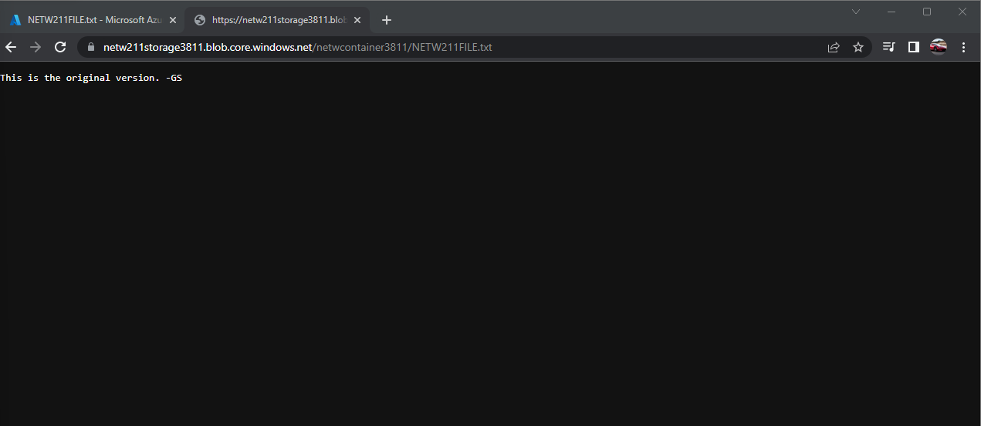
Creating Blob Snapshots
This screenshot shows the browser window with the “This is the original version. –Your Initials” message and the URL on top of the window

Slide 23
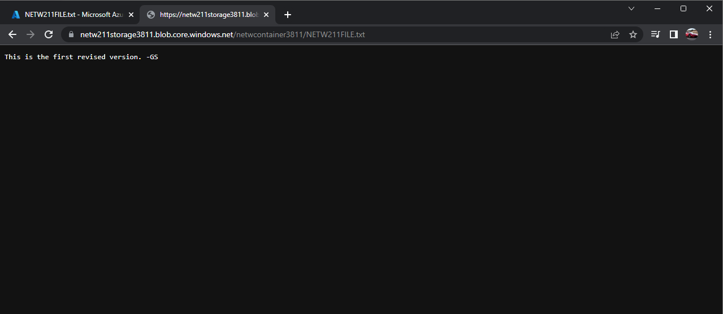
Enabling Blob Versioning
This screenshot shows the browser window with the “This is the first revised version. –Your Initials” message and the URL on top of the window.

Slide 24

NETW211 Course Project
Module 6 Cloud Monitoring

Slide 25
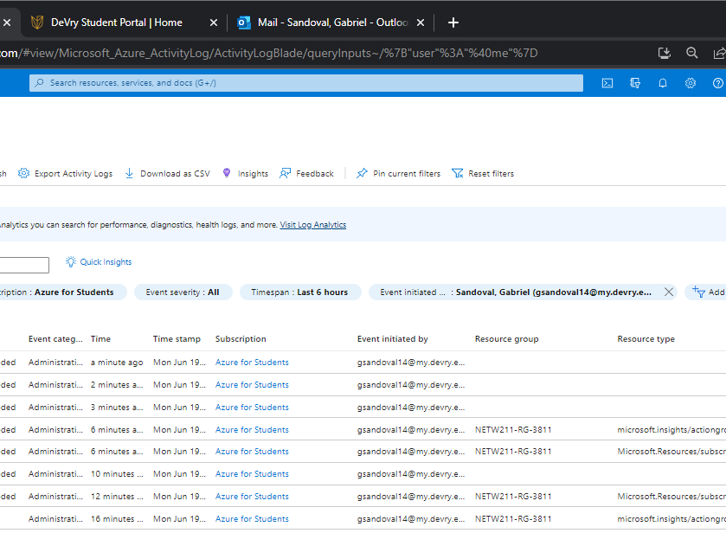
This screenshot shows the “VM-Status-Change” action group on the Manage actions page.
Setting up an Action Group and Notifications

Slide 26
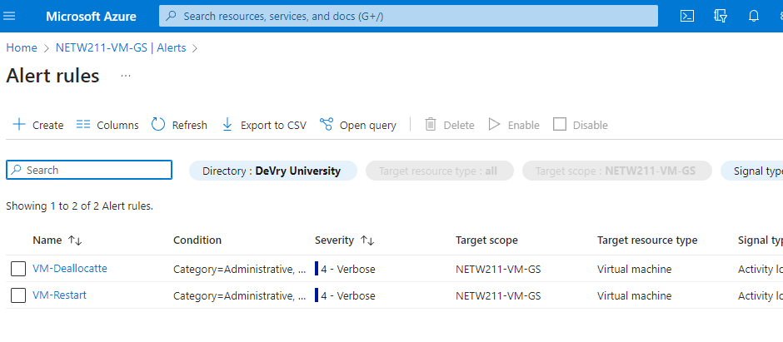
Setting up Alert Rules
This screenshot shows the Alert rules window showing the VM-Deallocate and VM-Restart rules.

Slide 27
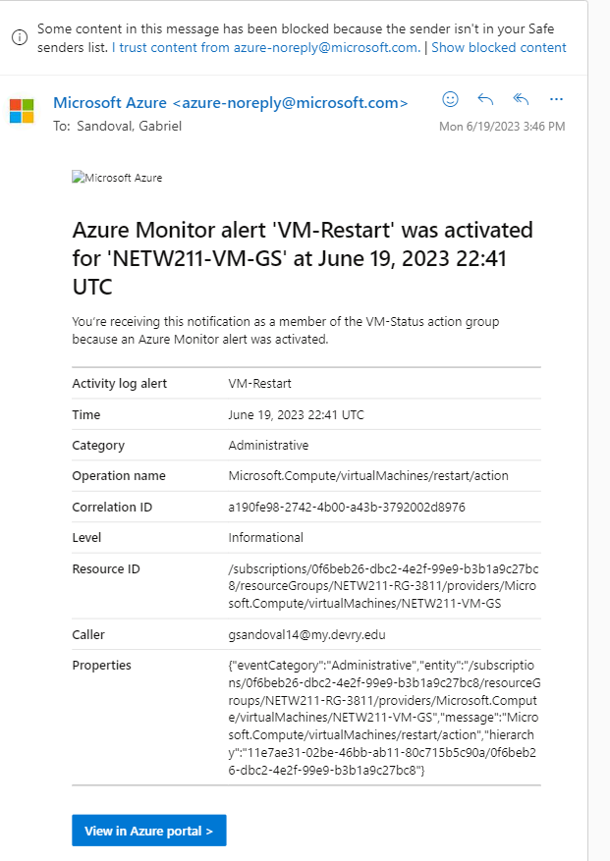
Testing Alerts
This screenshot shows the ‘VM-Restart’ was activated email message with the date and time of the alert.

Slide 28
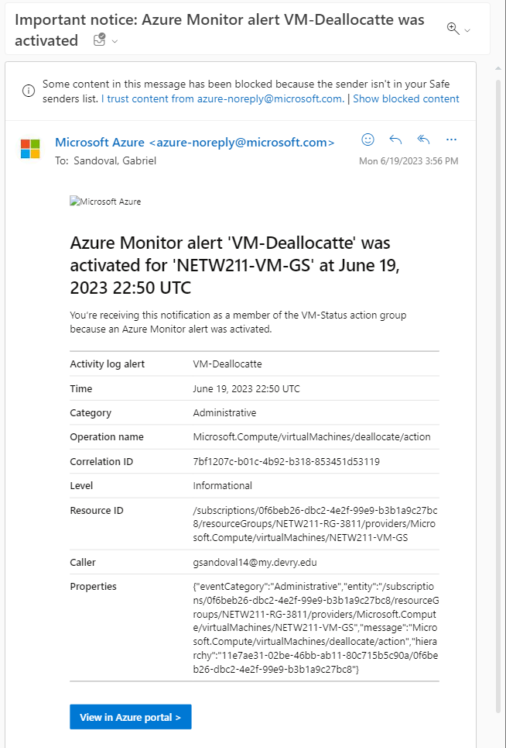
Testing Alerts cont’d
This screenshot shows the ‘VM-Deallocate’ was activated email message with the date and time of the alert.

Slide 29
Challenges
I didn’t experience many problems and when encountering one it would be due to my commands being improperly submitted preventing the ubuntu to process the command.

Slide 30
Skills
Creating a virtual machine
Cloud security
Monitoring performance
Microsoft Azure
Capacity planning
Troubleshooting
Writing codes

Slide 31
Conclusion
This course has given me an understanding due to the fact of the on hands project. This has allowed me to have the confidence in understanding how to create a virtual machine and its basic needs to run and function properly

Slide 32
References
Cloud computing services: Microsoft Azure. Cloud Computing Services | Microsoft Azure. (n.d.). https://azure.microsoft.com/en-us
Course project videos

