Slide 1
Gabriel Sandoval
PHYS204 Final Course Project

Slide 2
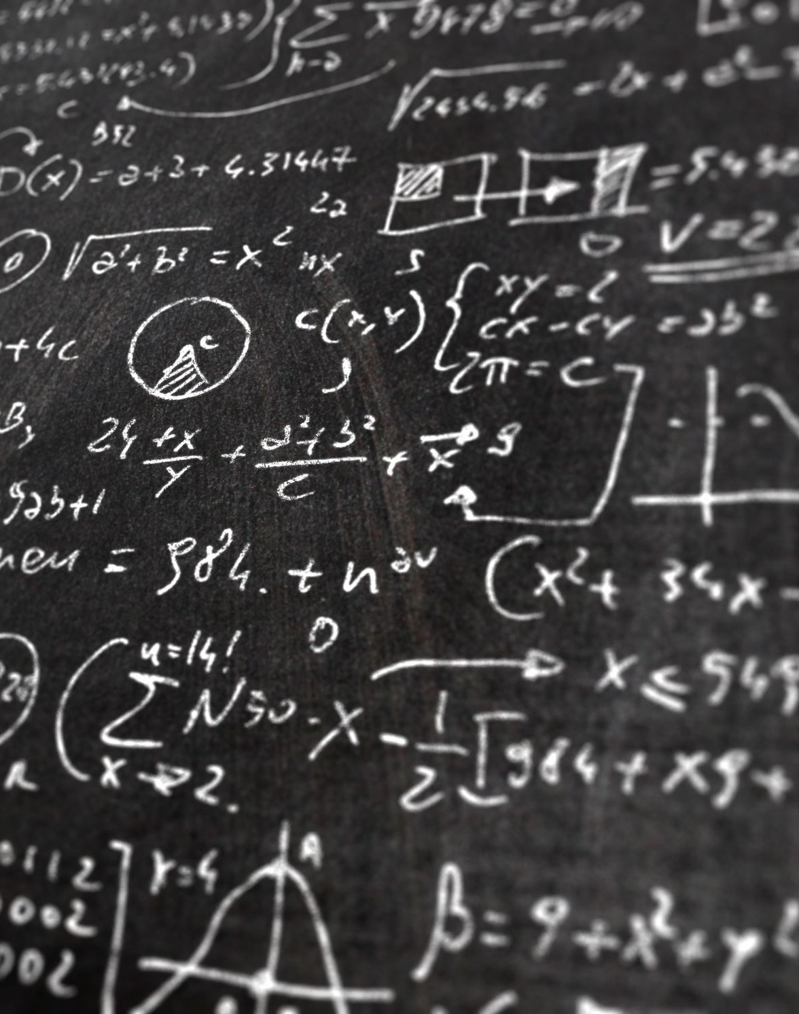
Introduction
Physics is everything and a better understanding of it is to do it. In this course, we conducted multiple projects with the ESP32 and Mega 2560 boards. The system we used to write the code to the system was Arduino allowing us to gather data that was needed to fulfill the projects.

Slide 3
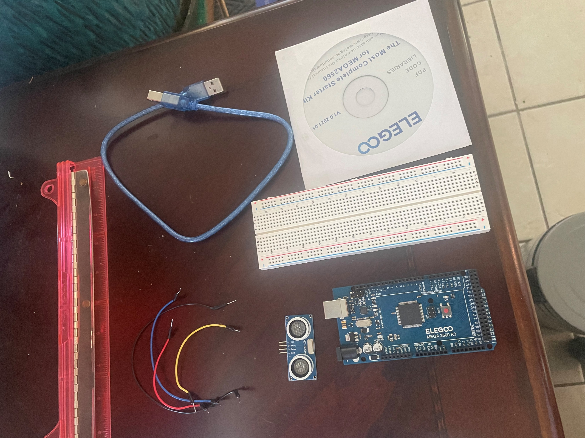
Materials List (Picture)
Module 1
Arduino Mega 2560
Ultrasonic sensor HC-SR04
Male to Male Wires
Breadboard
USB cable to connect Arduino
Ruler or tape measurer
Object to act as obstacle and/or undergo free-fall

Slide 4
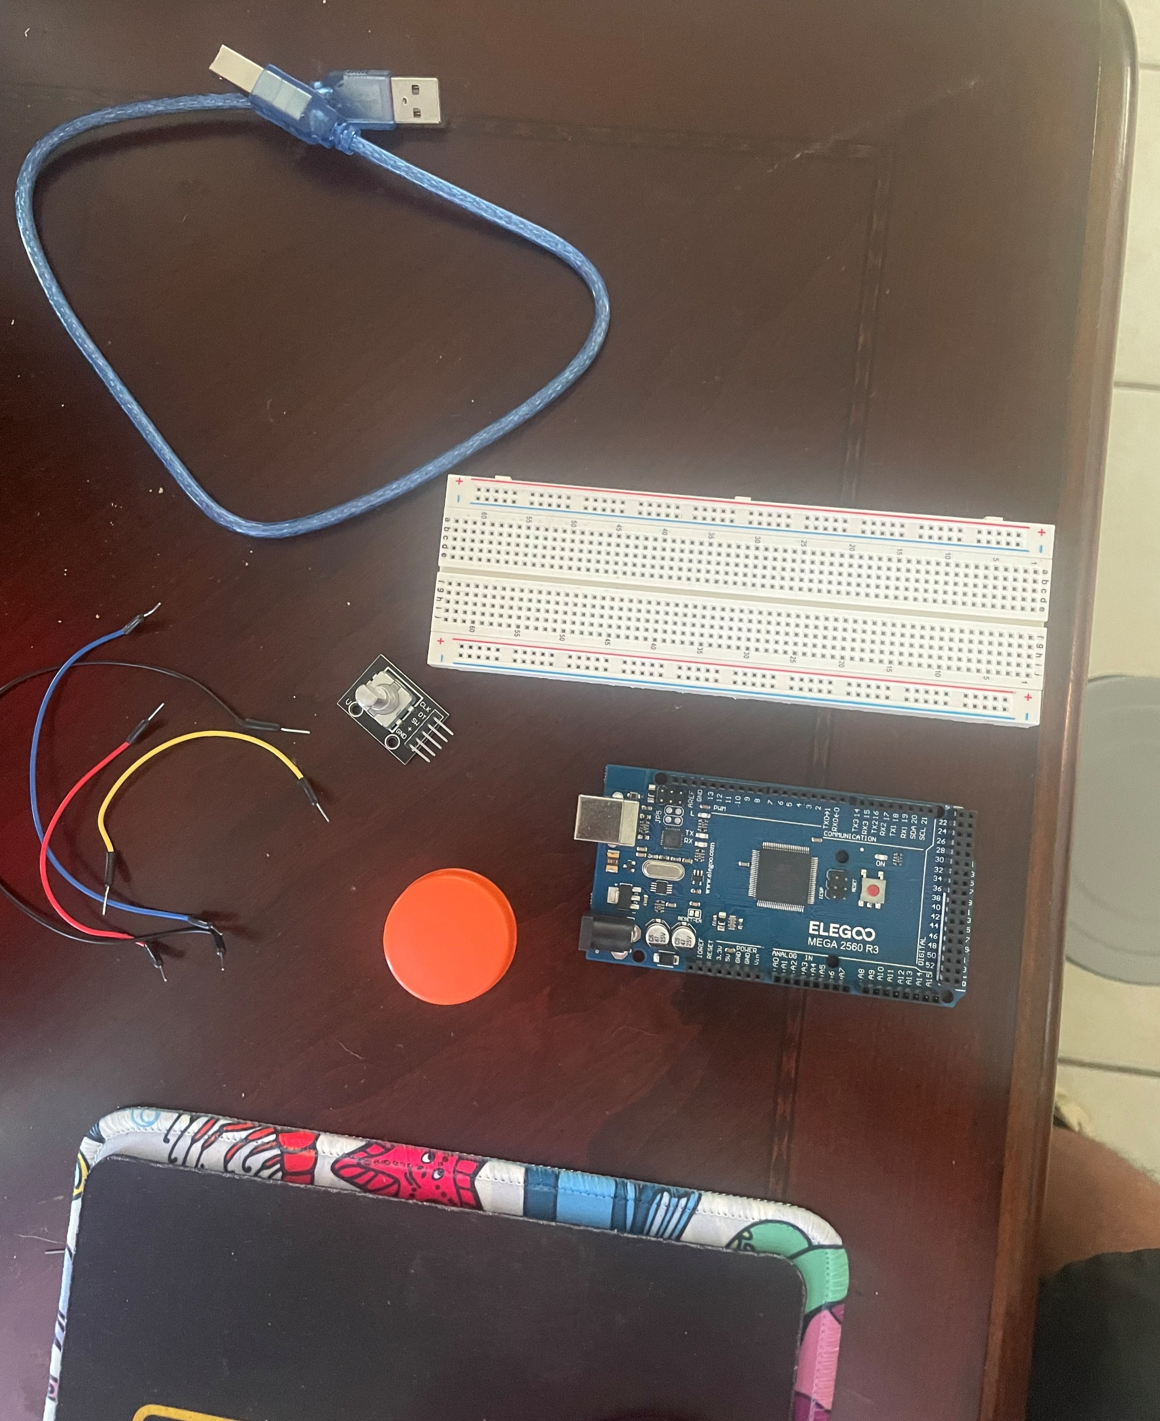
Materials List (Picture)
Arduino Mega 2560
Rotary Encoder Part KY-040
Male to Female Wires
USB cable to connect Arduino
Object to attach onto rotary encoder
Ruler or tape measurer

Slide 5
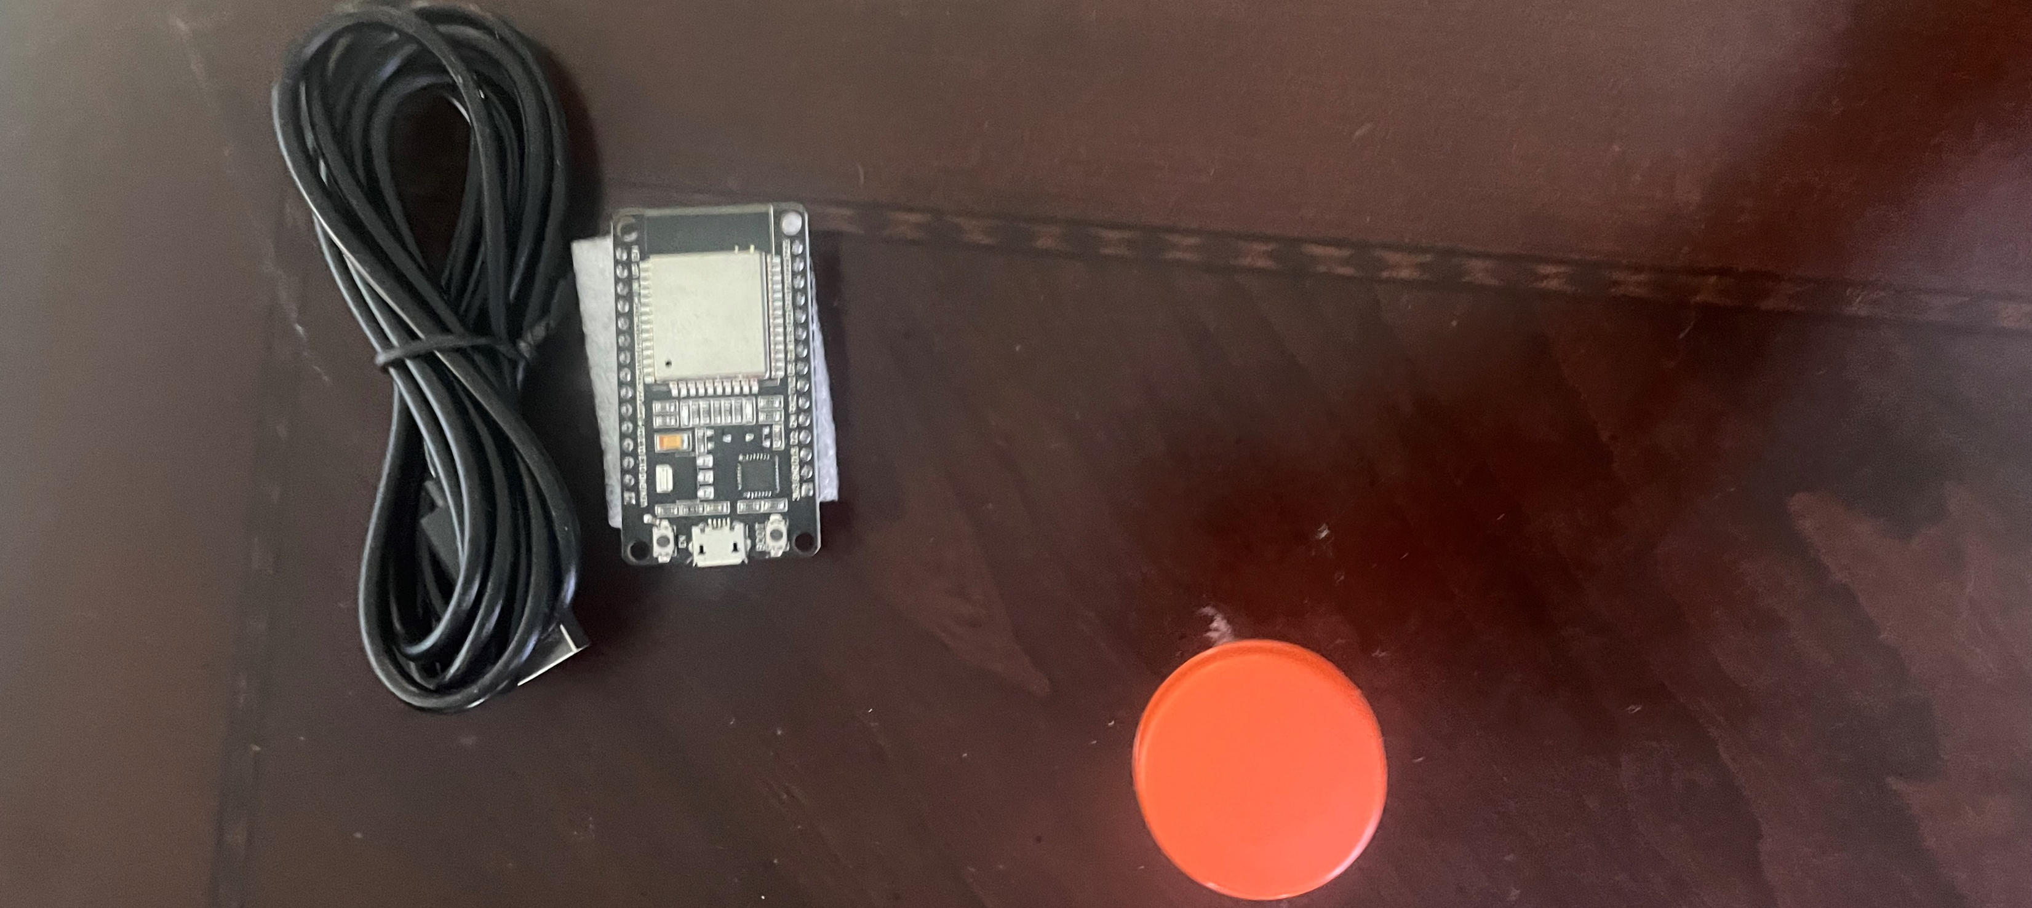
Materials List (Picture)
ESP32 microprocessor
Micro-USB cable
Magnet

Slide 6

Software
(screenshot)
Microsoft Excel installed and running on my computer

Slide 7
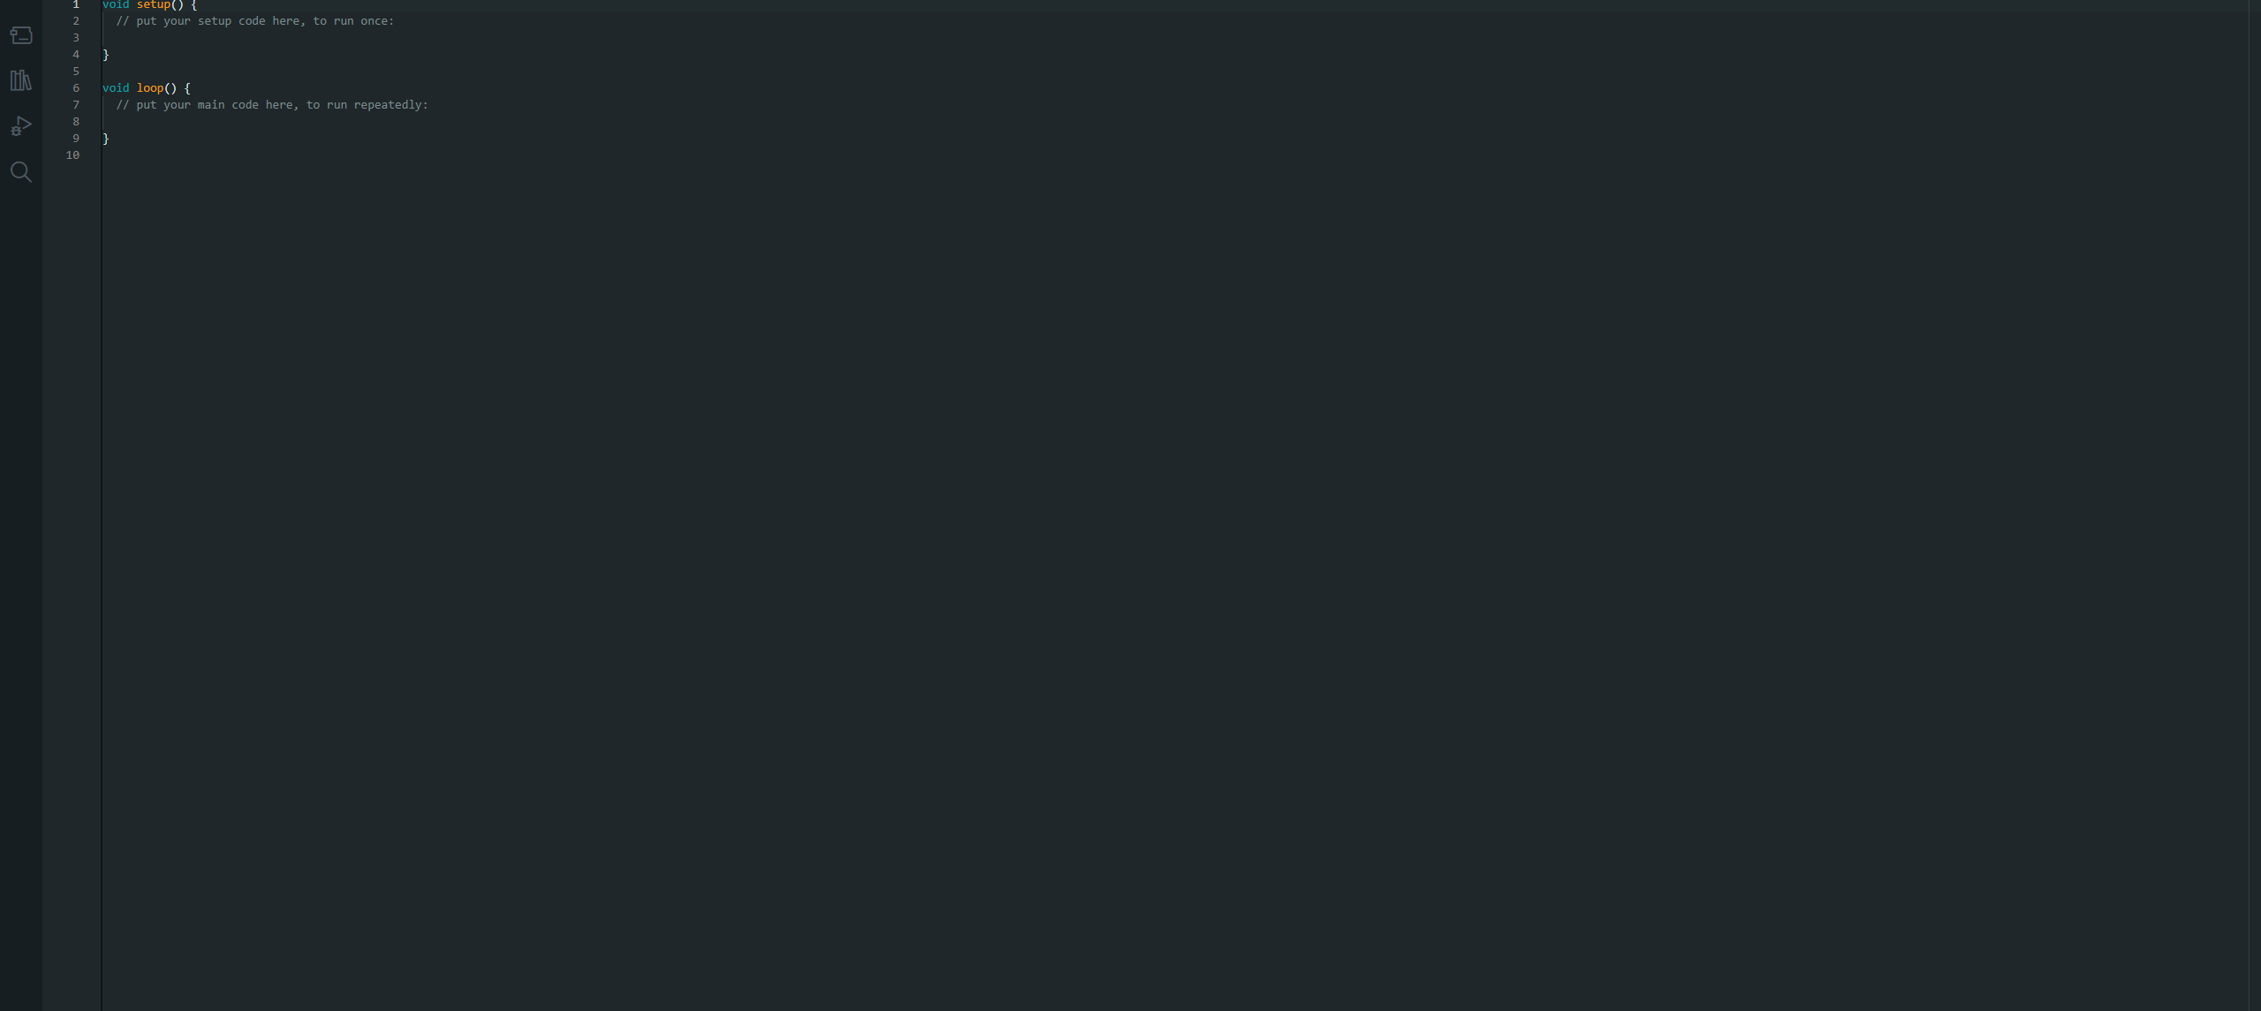
Software
Arduino IDE installed and running on my computer

Slide 8
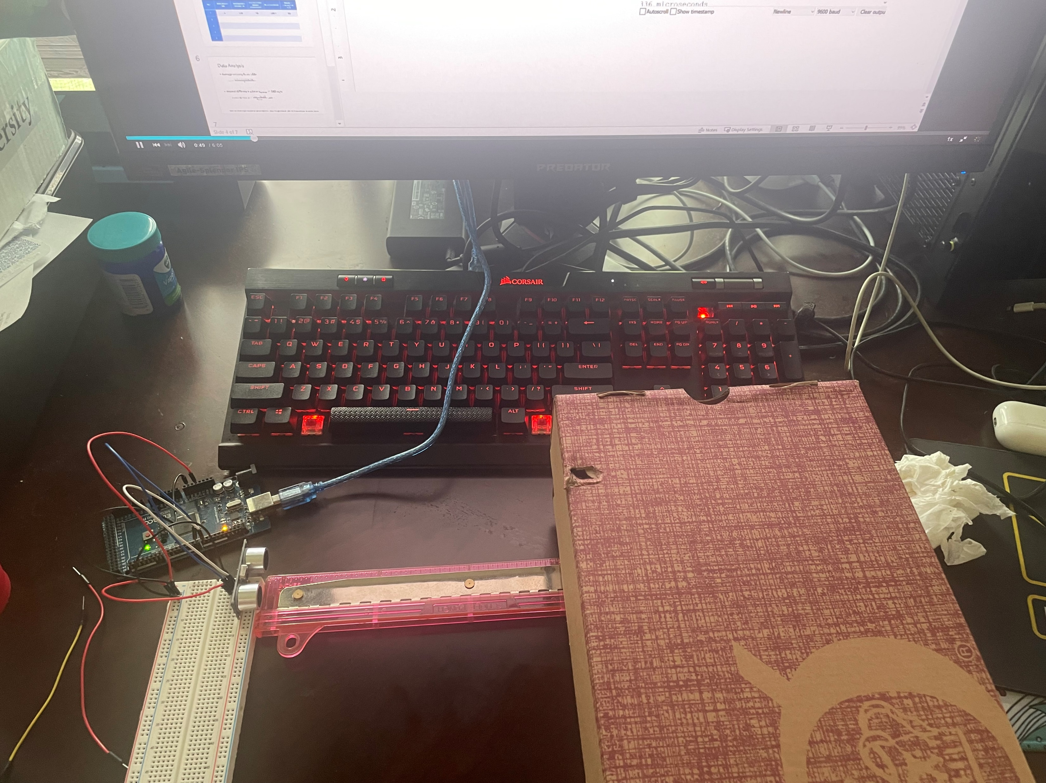
Experimental Set-up (Picture)
Module 2
Materials List:
Mega 2560 Board
Ultrasonic sensor HC-SR04
Male to Male Wires
Breadboard
Ruler or tape measurer
Large and flat object to act as obstacle

Slide 9
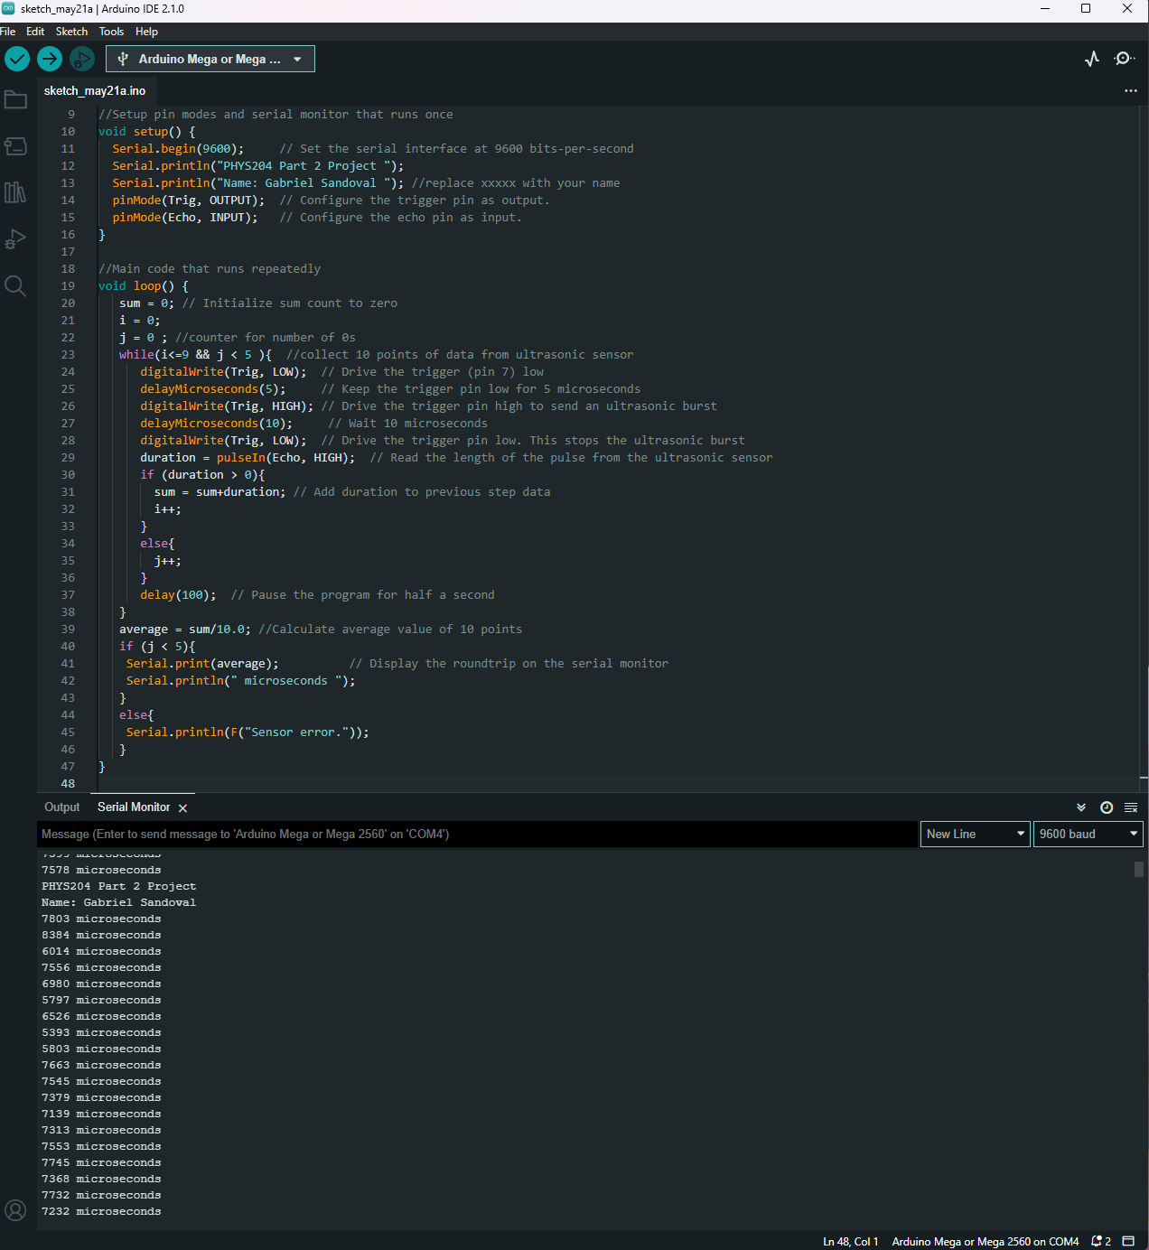
Raw Data (Screenshot)
Screenshot of Serial Monitor from Arduino IDE showing raw data.
name displayed in the serial monitor. include your

Slide 10
Data Collection
Trial | Ruler Distance (cm) | Roundtrip Total Distance (m) | Time from Serial Monitor (microseconds) | Converted Roundtrip Time (s) | Velocity = distance/time (m/s)
1 | 15.24 | 0.305 | 887 | 8.87e-4 | 343
2 | 5.08 | 0.102 | 260 | 2.60e-4 | 392
3 | 10.16 | 0.203 | 607 | 6.07e-4 | 334
4 | 2.54 | 0.0554 | 53 | 5.3e-4 | 104
5 | 25.4 | 0.508 | 1407 | 1.407e-4 | 3610

Slide 11
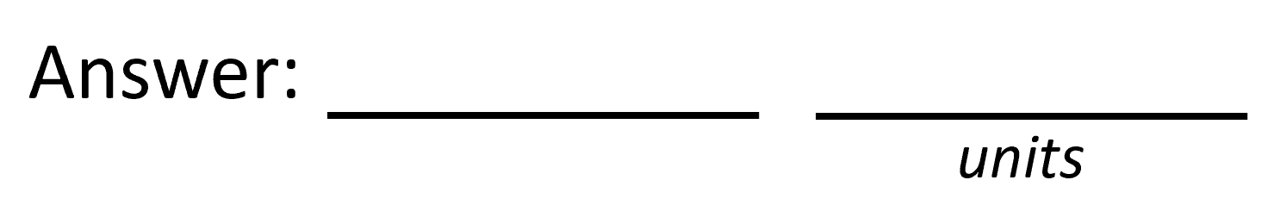
Data Analysis
Average velocity from table
956.6m/s
Percent difference where $v_{sound}=343 m/s$
$$v_{avg}= \frac{v_{1}+v_{2}+v_{3}+v_{4}+v_{5}}{5}$$
$Percent difference = \frac{\left|v_{avg}−v_{sound}\right|}{v_{sound}}×100$ $= \frac{\left|956.6−343\right|}{343}×100$
1.79%

Slide 12
Conclusions
Discuss the results and comment on the source of errors.
  Answer: A source I encountered is that my ruler only has inches rather than centimeters, because of this I had to convert inches into centimeters.
What is the dependence of temperature, humidity, and atmospheric pressure on the speed of sound? How does it affect the results?
  Answer: When I conducted this project I did it in an uncontrolled room with a window opened. The conditions of this room humidity were at 63% and °75 degrees.

Slide 13
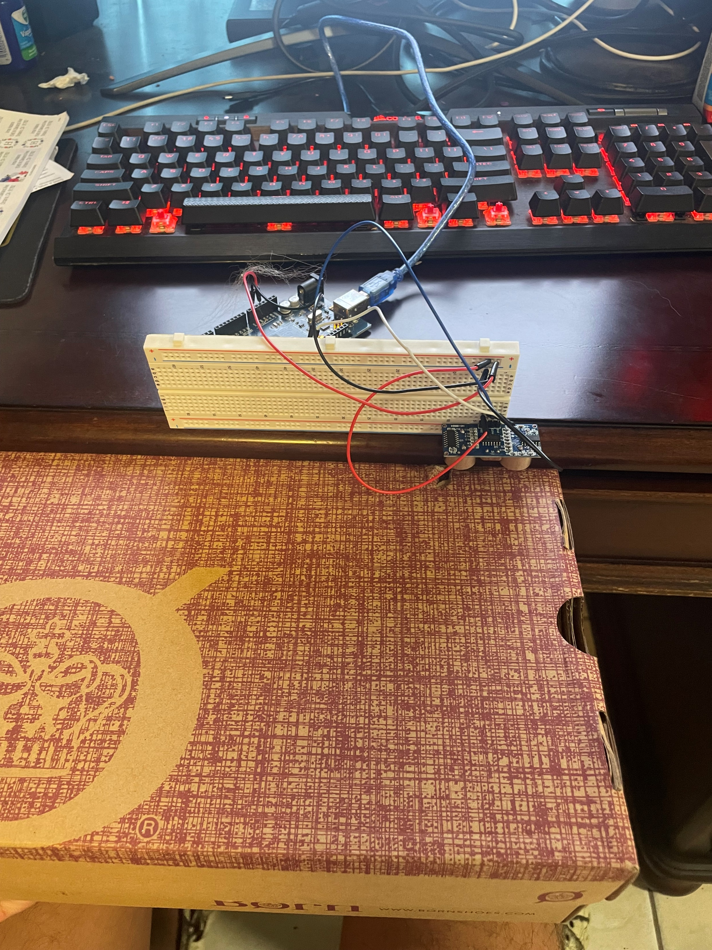
Experimental Set-up (Picture)
Module 3
Materials List:
Mega 2560 Board
Ultrasonic sensor HC-SR04
Male to Male Wires
Breadboard
Large and flat object that is not susceptible to air resistance to undergo free fall motion

Slide 14
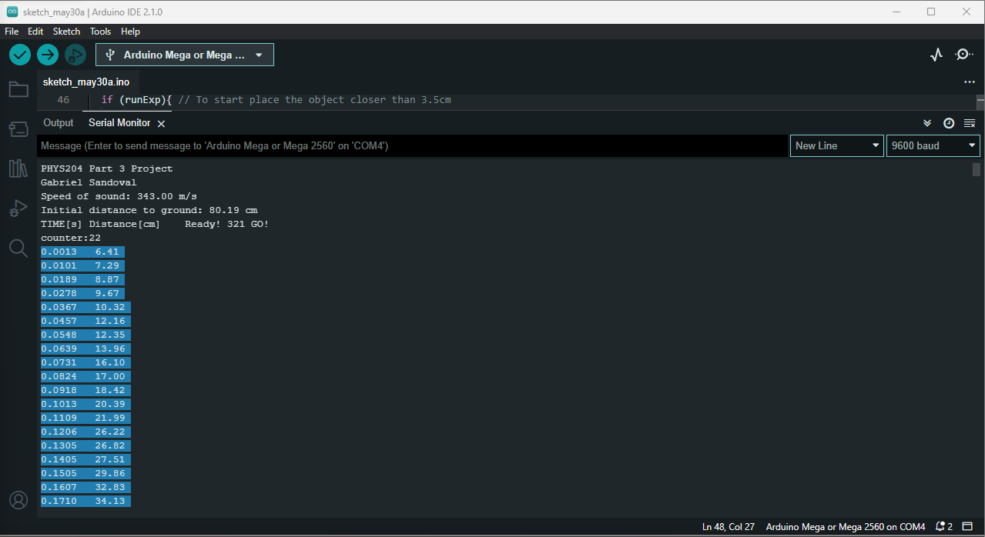
Serial Monitor (Screenshot)
screenshot of raw data showing the start of the fall and the end of the fall of one trial.

Slide 15
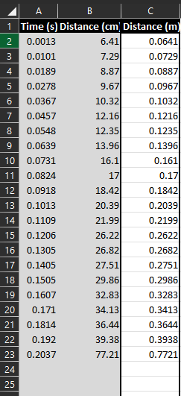
Excel Table
(Screenshot)
All values in the Excel table for a single trial showing the fall distance in centimeters and meters as a function of time.

Slide 16
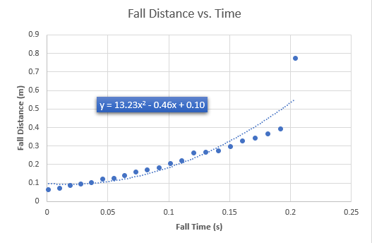
Excel Graph
(Screenshot)
Excel graph for a single trial showing the fall distance as a function of time.

Slide 17
Data Collection
Trial | x² coefficient value from curve fitting | Acceleration (m/s²) = 2* (x² coefficient)
1 | 13.23 | 26.46
2 | 21.84 | 43.68
3 | 29.39 | 58.78
4 | 20.65 | 41.30
5 | 7.20 | 14.40

Slide 18
Data Analysis
Average acceleration from table
Percent difference with $g=9.8 m/s^{2}$
$$a_{avg}= \frac{a_{1}+a_{2}+a_{3}+a_{4}+a_{5}}{5}$$
36.924
$$Percent difference =\frac{\left|a_{avg}−g\right|}{g}×100$$
2.77%

Slide 19
Conclusions
Discuss the results and comment on the source of errors.
  Answer: My results are great based on the reference videos for module 4. A source of errors would be that the ultrasonic sensor would have the incorrect cm measurement and instead of reading at 80cm, it would read at 18cm.
How much variation is there from trial to trial? What does this indicate about the uncertainty of the result?
  Answer: There are some differences between all 5 trials with different results each time. Having said that, the ultra sonic sensor is not always 100% accurate.

Slide 20
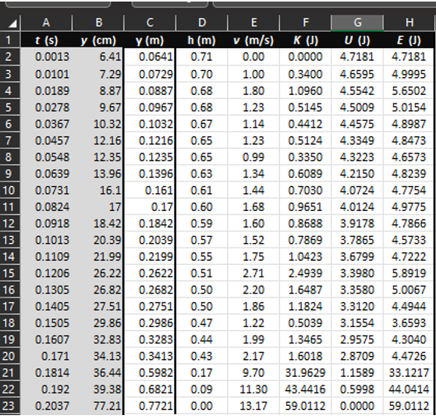
Excel Table (Screenshot)
All values in the Excel table for a single trial show the fall distance in centimeters and meters as a function of time with the values generated for kinetic energy K, potential energy U, and total mechanical energy E.
Module 4

Slide 21
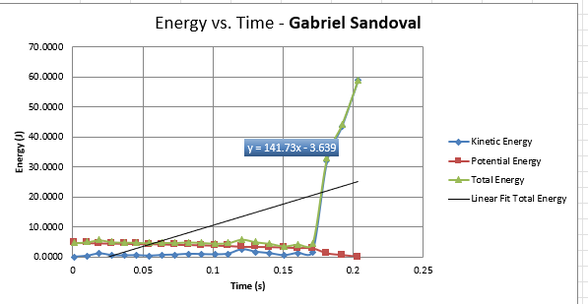
Excel Graph (Screenshot)
Include Excel graph for a single trial showing the plots of the kinetic energy K, potential energy U, and total mechanical energy E as a function of time.

Slide 22
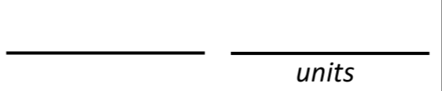

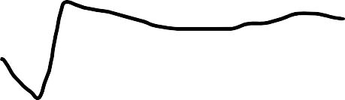
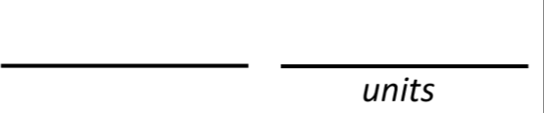


Data Analysis
Theoretical value of final velocity
^{ℎ = 𝑦}𝑓𝑖𝑛𝑎𝑙 ^{− 𝑦}𝑖𝑛𝑖𝑡𝑖𝑎𝑙 ⁼
0.7721-0.0641=0.708m
𝑣_{𝑓} = 2𝑔ℎ =
2*9.8*0.708=3.7251m/s
Final velocity from experimental data (or largest velocity)
^{𝑣}𝑒𝑥𝑝𝑒𝑟𝑖𝑚𝑒𝑛𝑡𝑎𝑙 ⁼
13.17
Percent difference
3.7251 − 13.17
𝑃𝑒𝑟𝑐𝑒𝑛𝑡 𝑑𝑖𝑓𝑓𝑒𝑟𝑒𝑛𝑐𝑒 =
× 100
3.7251
25354.75%

Slide 23
Conclusions
Discuss the key characteristics of the plot. Consider the points when potential energy U is maximum, U is minimum, kinetic energy K is maximum, K is minimum and when U and K are the same value. What is the significance of these points?
  Answer: The plots in my graph are together throughout most of the graph however the total energy line shoots up as the box gets closer to the floor.

Slide 24
Conclusions
What is the trend of the best fit line for the total energy E in your data? If the data is accurate, the total mechanical energy should decrease slightly. Why is that?
  Answer:
On the contrary, mine continues to go in the upwards direction, there is a stop, however, I am unsure if it could be a malfunction my ultrasonic sensor has because it has given me inaccurate information.

Slide 25
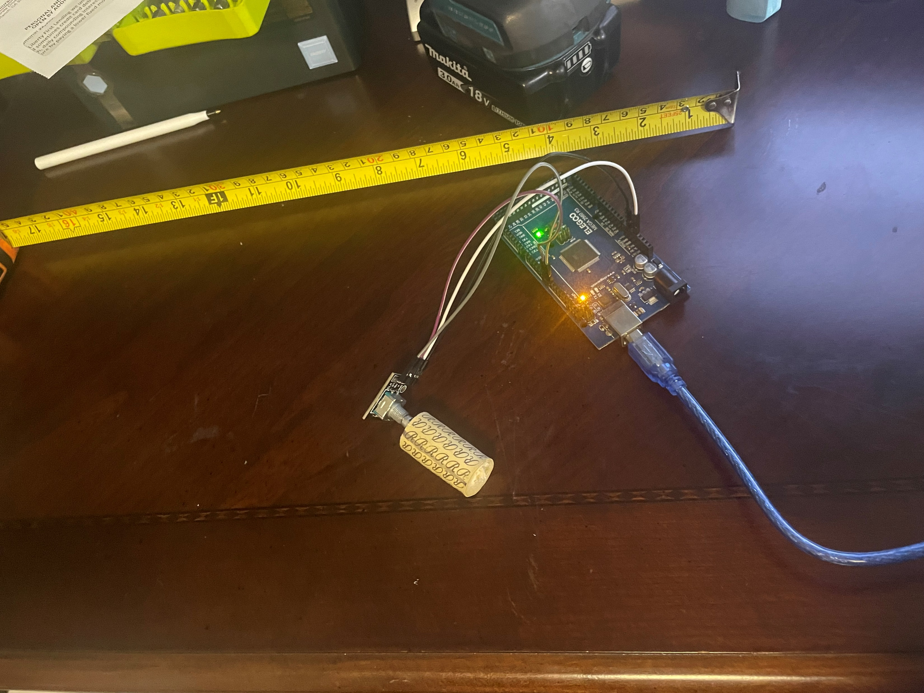
Experimental Set-up (Picture)
Module 5
Materials List:
Mega 2560 Board
Rotary Encoder Part KY-040
Male to Female Wires
Object to attach onto rotary encoder
(e.g. cork, bottle cap, ball)
Ruler or tape measurer

Slide 26
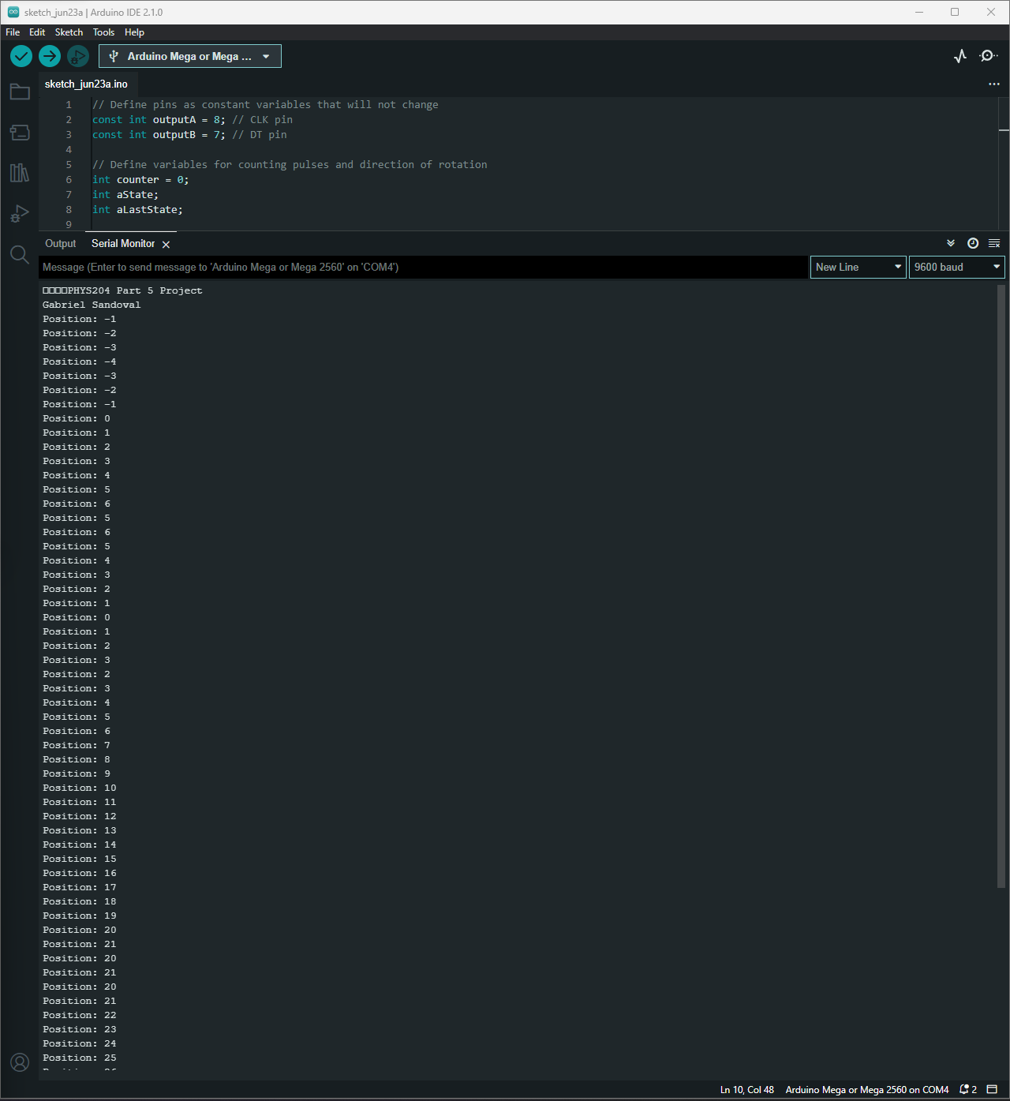
Raw Data (Screenshot)
Screenshot of Serial Monitor from Arduino IDE showing raw data.

Slide 27
Data Collection
1.27
Object diameter: d =
Object radius: r =
Number of pulses for one revolution: x =
Resolution = $\left(\frac{1 }{40 } \frac{Revolution}{pulses}\right)∙\left(\frac{2∙π radians}{1 Revolution}\right)=$
0.635
40
0.157 radius/pulses

Slide 28
Data Analysis
Trial | Number of pulses N | Encoder distance r$∙Resolution∙$ N | Measured distance with ruler | Percent difference
1 | 84 | 0.653*0.157*84=8.61 | 15.24cm | [|15.24-8.61|/15.24] *100= 43.50%
2 | 164 | 0.653*0.157*164=16.81 | 25.4 | [|25.4-16.81|/25.4]*100= 33.81%
3 | 68 | 0.653*0.157*68=6.97 | 20.32 | [|20.32-6.97|/20.32]*100= 65.69%
4 | 28 | 0.653*0.157*28=2.87 | 22.86 | [|22.86-2.87|/22.86]*100= 87.44%
5 | 136 | 0.653*0.157*136=13.94 | 24.13 | [|24.13-13.94|/24.13]*100= 42.22%

Slide 29
Conclusions
Discuss the results and comment on the sources of error.
  Answer: I think the source of error is myself, I think in this project I was able to gather firm data however, since I have had problems with other sensors, I tend to think I may have incorrect data.
What are some applications of this measuring technique? Could this measuring system be used to measure surfaces that are not flat?
  Answer: I had some problems having enough traction with the wine cork however, on a nonflat surface I think there would be different results.

Slide 30
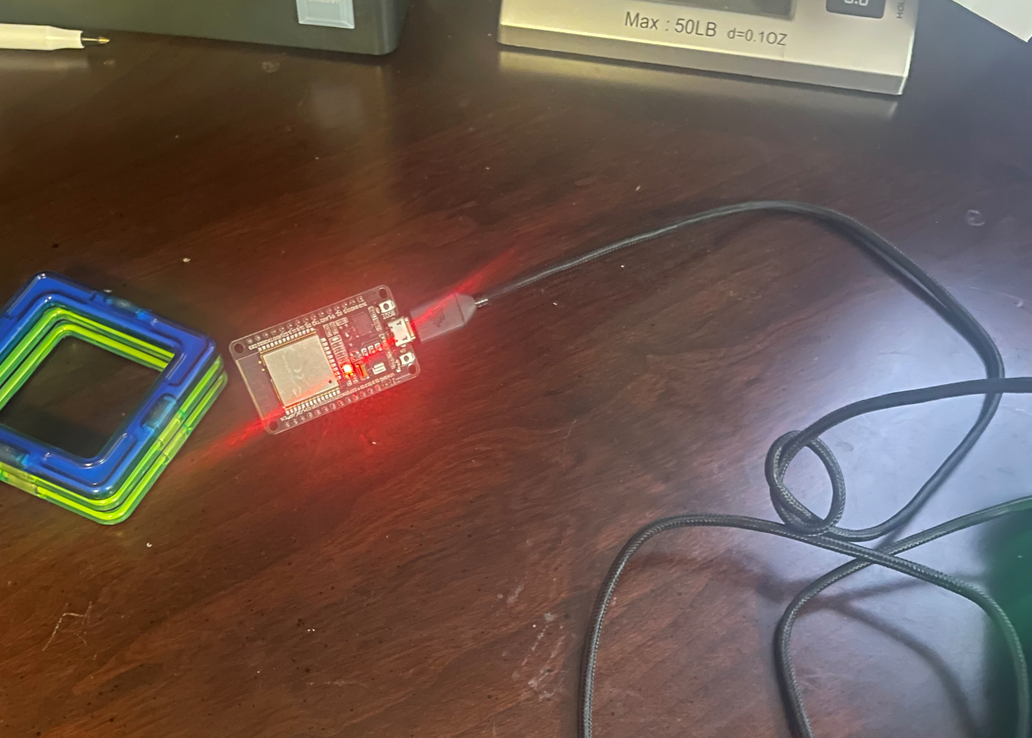
Experimental Set-up (Picture)
Module 6
Materials List:
ESP32 microprocessor
Micro-USB cable
Magnet

Slide 31
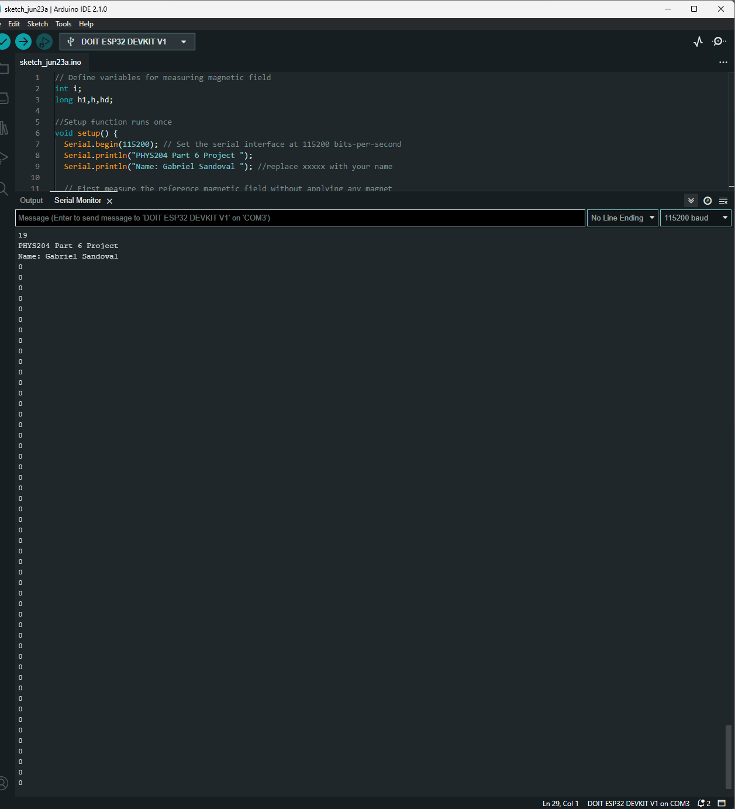
Raw Data (Screenshot)
Screenshot of Serial Monitor from Arduino IDE showing raw data.

Slide 32
Excel Graph
(Screenshot)
Excel graph for a single trial of data plotted as a function of time.

Slide 33
Conclusions
Discuss the results and comment on the sources of error.
  Answer:
  A source of error would be when the magnet touches other pins in the esp32 it causes a faulty code to occur making an error in the serial monitor.
Describe how the Hall sensor works. What are some applications for the Hall effect sensor?
  Answer: Hall sensors work by the change in voltage when the esp32 is placed near a magnet. This allows us to understand speed control.

Slide 34
Challenges
What challenges did you face and overcome? A challenge that I faced often was working with my ultrasonic sensor. It would constantly give me inaccurate results when doing log. However, after a thorough review, I came to the conclusion that I had a faulty sensor.
What parts of the project created the most difficulty? The most difficult part was dealing with inaccurate data and trying to complete the project. It wasn’t until multiple attempts to fix it that I was able to gather somewhat good data.

Slide 35
Career Skills
What skills were developed that will benefit your career? Skills that were developed in this course were data logging, critical thinking, and understanding external factors like air pressure, and humidity. I see myself doing in the IT field, however, the skills I developed throughout this course are extremely beneficial to any career I decide on doing.
What competencies will help you gain the opportunities to advance your career? The knowledge of physic in the IT field is important. Depending on the field of IT, it can be used to create data centers or new machines.

